Slide 1
ET TUTORIAL
Single Phase Transformer Basics

Slide 2

1. The primary of transformer has 200 turns and is excited by a 60Hz, 200V source. What is the maximum value of flux?
Ans:$4.13 mWb$

Slide 3
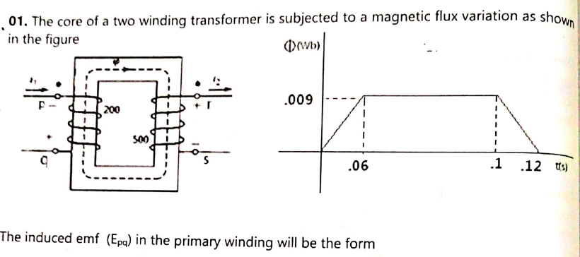
2

Slide 4
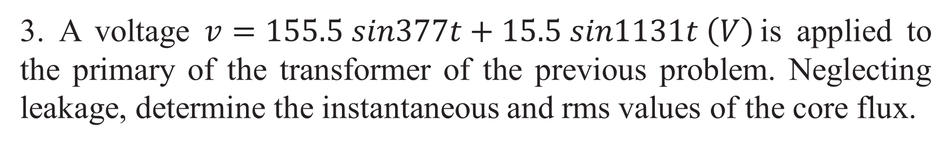

3. A voltage $v=155.5 sin377t+15.5 sin1131t \left(V\right)$ is applied to the primary of the transformer of the previous problem. Neglecting leakage, determine the instantaneous and rms values of the core flux.
Ans:$1.45 mWb$

Slide 5
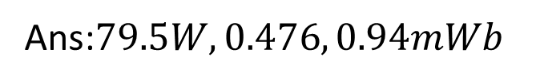
4. A 60Hz t/f having a 480 turn primary winding takes 80W and 1.4A at no load with input voltage of 120V. If the primary winding resistance is 0.25 Ω, determine (a) the core loss, (b) the no-load power factor and (c) the maximum core flux (neglect the primary resistance and reactance drops)
Ans:$79.5W, 0.476, 0.94mWb$

Slide 6
5. A transformer has 180 and 90 turns in its secondary and primary windings respectively. The respective resistances are 0.233Ω and 0.067Ω. Calculate the equivalent resistance of (a) primary referred to secondary (b) secondary referred to primary and (c) the total resistance of t/f referred to the primary.

Slide 7
6. A 20-kVA, 50-Hz, 2000/200-V distribution transformer has a leakage impedance of 0.42 + j 0.52 Ω in the high-voltage (HV) winding and 0.004 + j 0.05 Ω in the low-voltage (LV) winding. When seen from the LV side, the shunt branch admittance Y₀ is (0.002 – j 0.015) Ω (at rated voltage and frequency). Draw the equivalent circuit referred to (a) HV side and (b) LV side, indicating all impedances on the circuit.
Ans: Ref to HV: Z₂’ = 0.4 + j 0.5 Ω
Y₀’ = (0.002 – j 0.015) 10⁻² Ʊ
Ref to LV: Z₁’ = 0.0042 + j 0.0052 Ω

Slide 8

7. A single phase t/f has 400 primary and 1000 secondary turns. The net cross sectional area of the core is 60 cm². If the primary is connected to a 50Hz supply at 500V, determine (a) the peak value of flux density in the core and (b) the voltage induced in the secondary winding.
Ans:$0.938 Wb/m2, 1250V$

Slide 9
8. A transformer on no-load has a core-loss of 50 W, draws a current of 2 A (rms) and has an induced emf of 230 V (rms). Determine the no-load power factor, core-loss current and magnetizing current. Also calculate the no-load circuit parameters of the transformer. Neglect winding resistance and leakage flux.
Ans: no load pf: 0.108 lag,
I_{w} = 0.216 A
G_{w} = 0.945mƱ
B_{m} = 8.64mƱ

Slide 10
9. A 40kVA transformer with a ratio of 2000/250V has a primary resistance of 1.15Ω and secondary resistance of 0.0155Ω. Calculate (a) total resistance referred to secondary and (b) total copper loss in full load.
Ans: 0.0334Ω
956.8 W

